Slide 1

Food Recommendation System
Project Defense
Presented By:
Supath Shrestha(25705/077)
Suyog Shrestha(25707/077)
Uddhab Shrestha(25708/077)
Date: 29th Jan, 2025

Slide 2
Introduction
Food Recommendation system, a system which recommends food item to users.
Implemented by using Collaborative Filtering and Content Based Filtering.
Developed to recommend foods based on user ratings.
Suggest similar foods based on the food ingredients.

Slide 3
Problem Statements
Choosing a particular food items is challenging task.
Difficulty for restaurant to increase food sales.

Slide 4
Objectives
To develop a personalized recommendations using collaborative filtering approach.
To boost restaurant sales.

Slide 5
Algorithms Used
Used Singular Value Decomposition (SVD) approach for model-based Collaborative Filtering.
Used Term Frequency- Inverse Document Frequency (TF-IDF) and cosine similarity for Content Based Filtering.

Slide 6

SVD
Matrix factorization technique
Decomposes user-item interaction matrix R into three matrices:
R = U. Σ. $V^{T}$
Where,
U: User latent matrix
Σ: Diagonal matrix of singular values
$V^{T}$: Item latent matrix

Slide 7

TF-IDF
TF measures how often a term t appears in a document d.
TF(t, d)$=\frac{Number of times t appears in document d}{Total number of terms in document d}$
IDF measure how unique a term is across all documents in dataset.
IDF(t,D)$=log⁡(\frac{Total number of documents in datset D}{Number of documents containing the term t}$)
TD-IDF gives weight to each terms in a document
TF-IDF(t, d) =TF(t, d) * IDF(t, D)

Slide 8

Cosine Similarity
Calcualtes the cosine angle between two vectors.
Measure the similarity between two vectors.
Cosine Similarity $=\frac{A.B}{\left|A\right|.|B|}$
Value ranges from [-1,1].

Slide 9
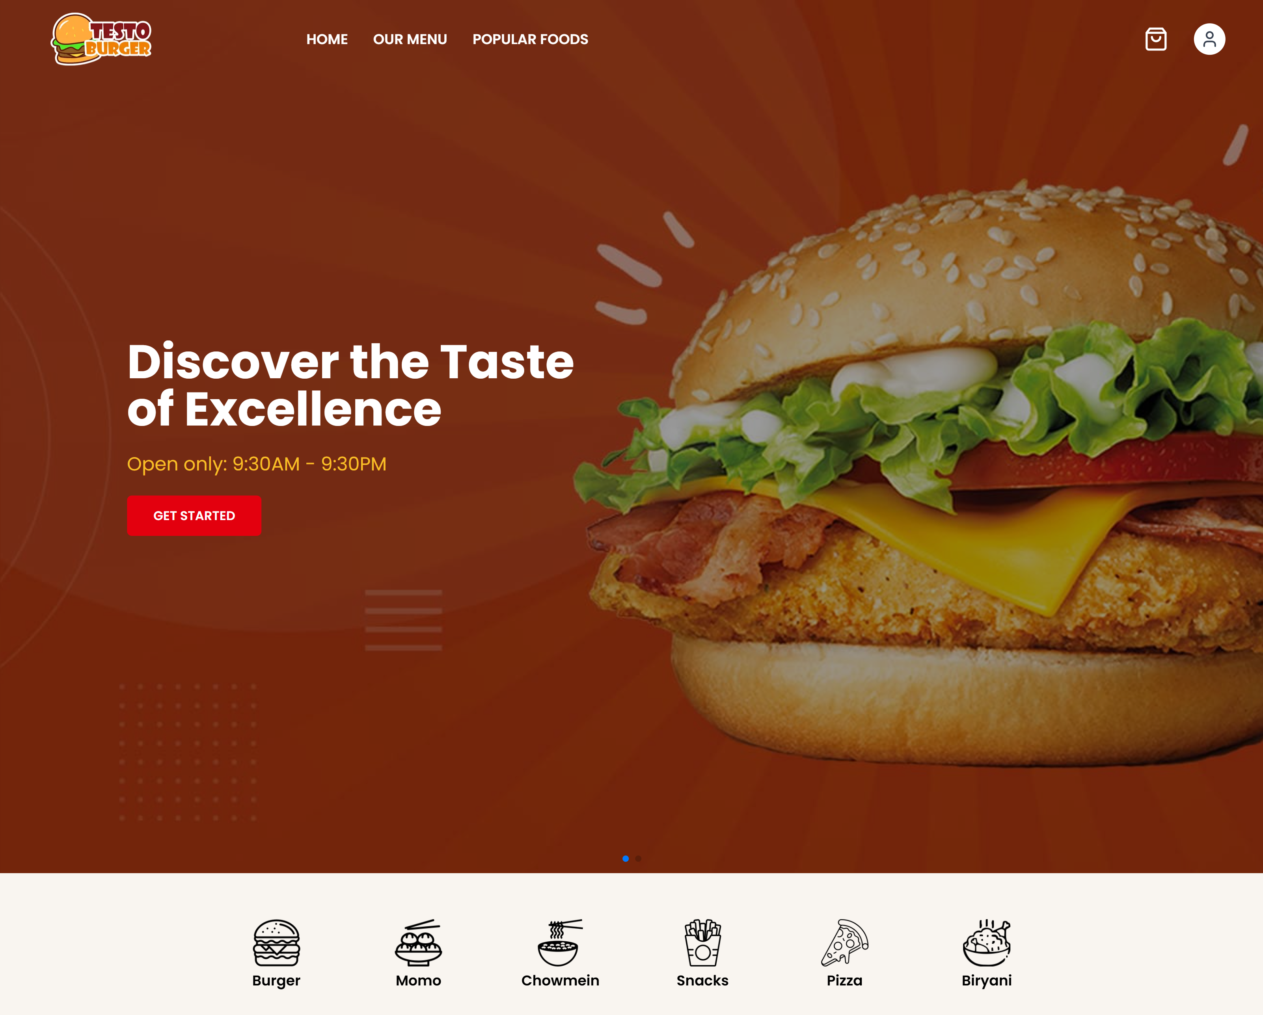

Slide 10
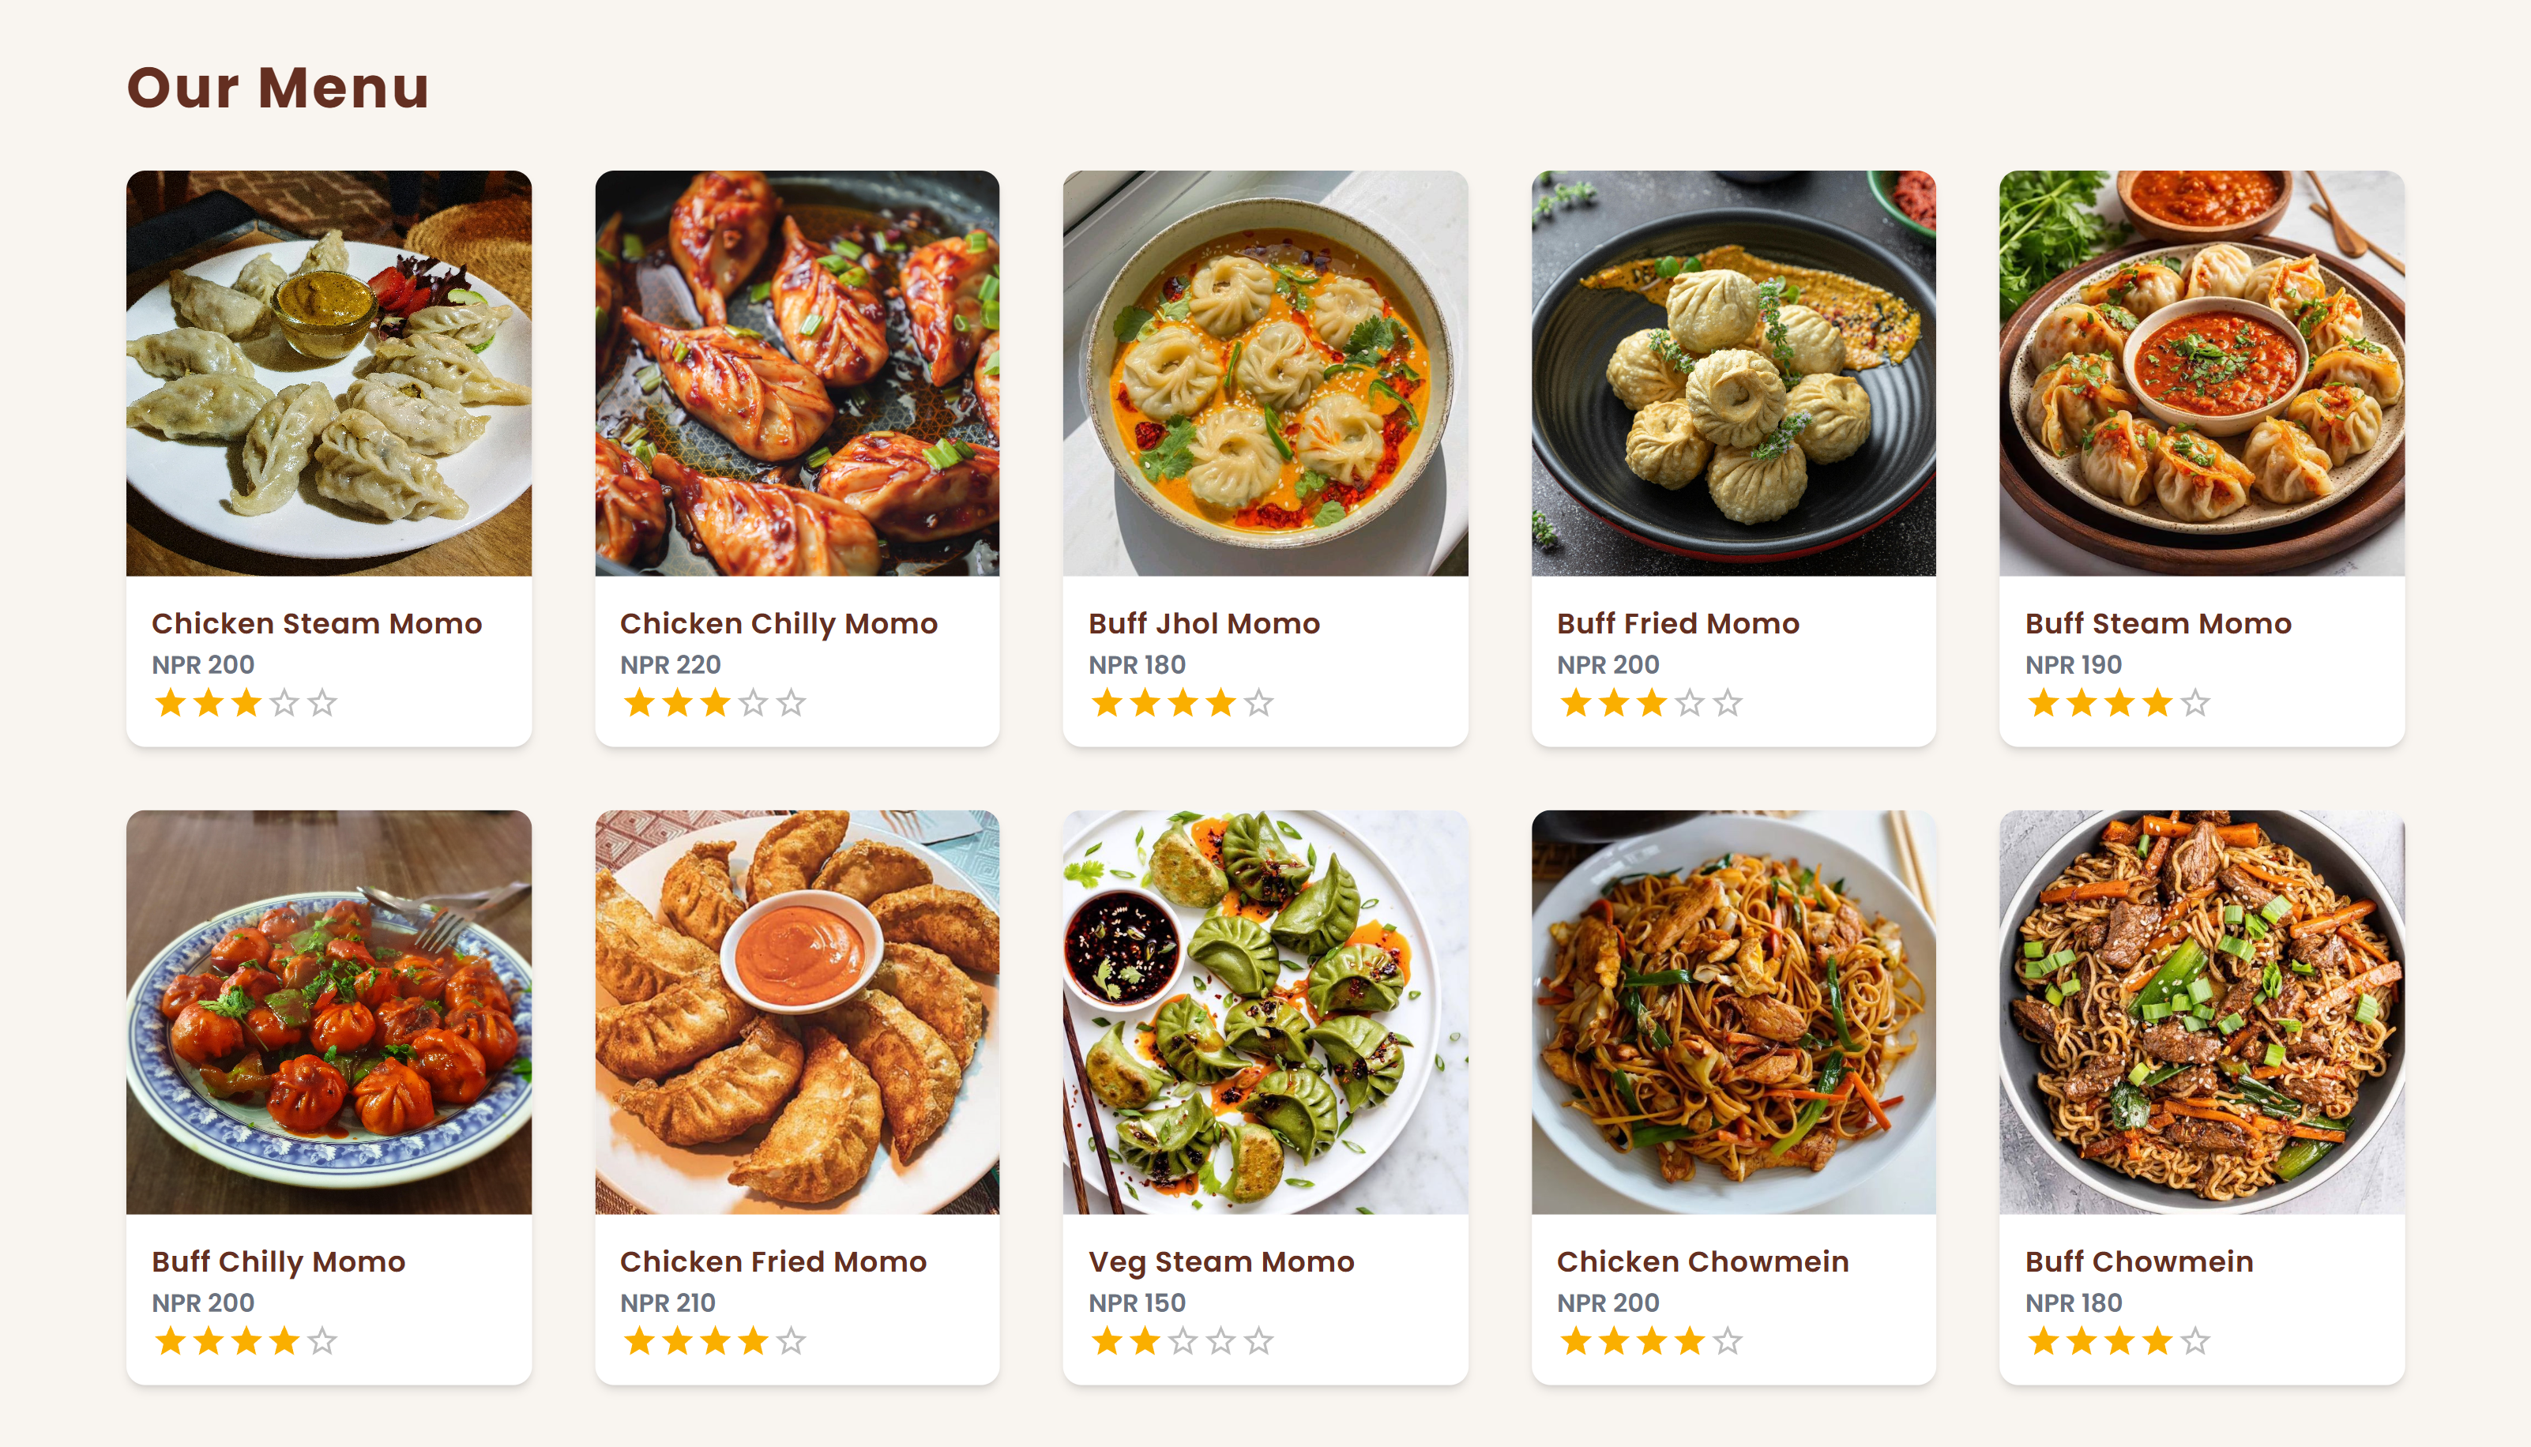

Slide 11
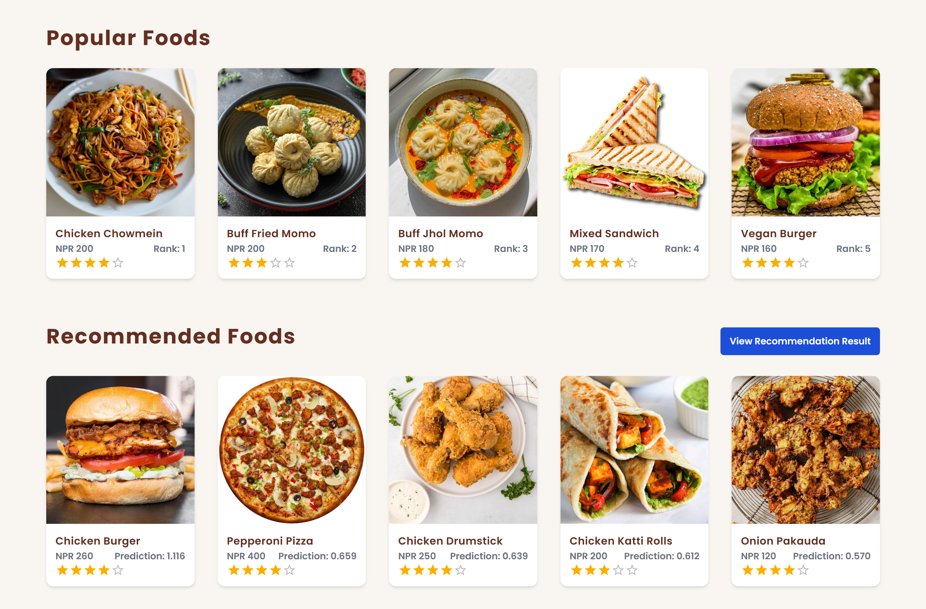

Slide 12
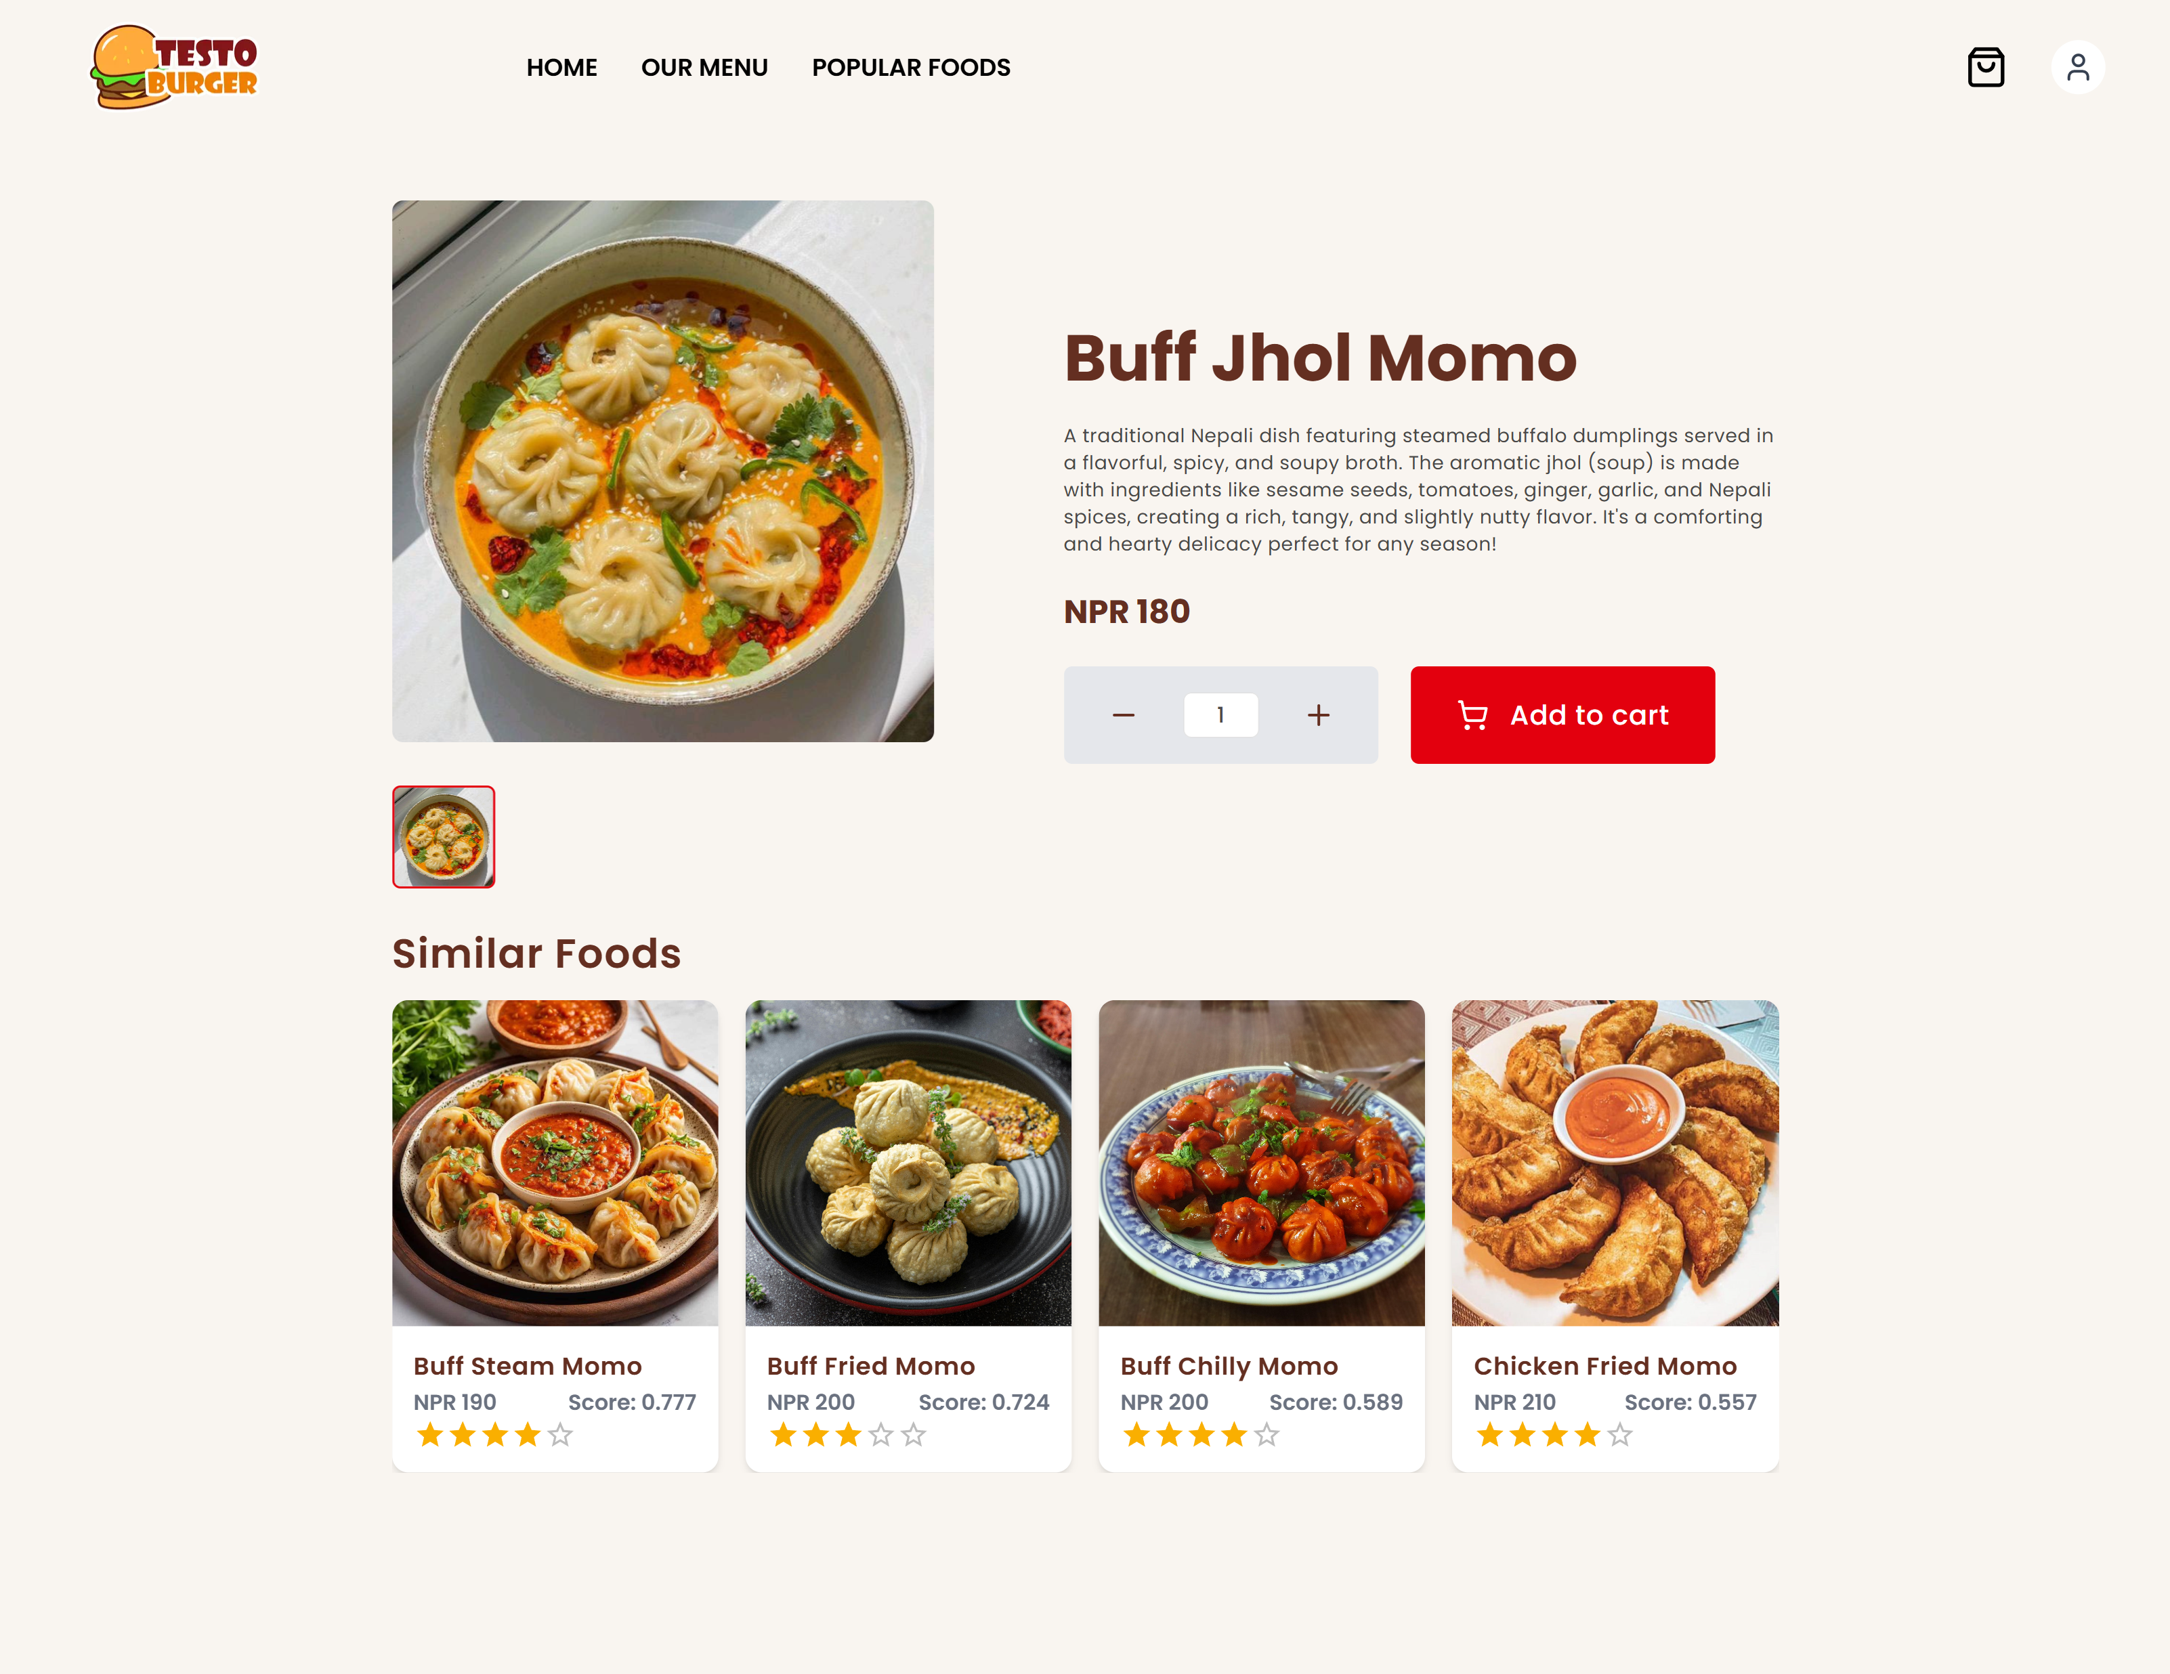

Slide 13
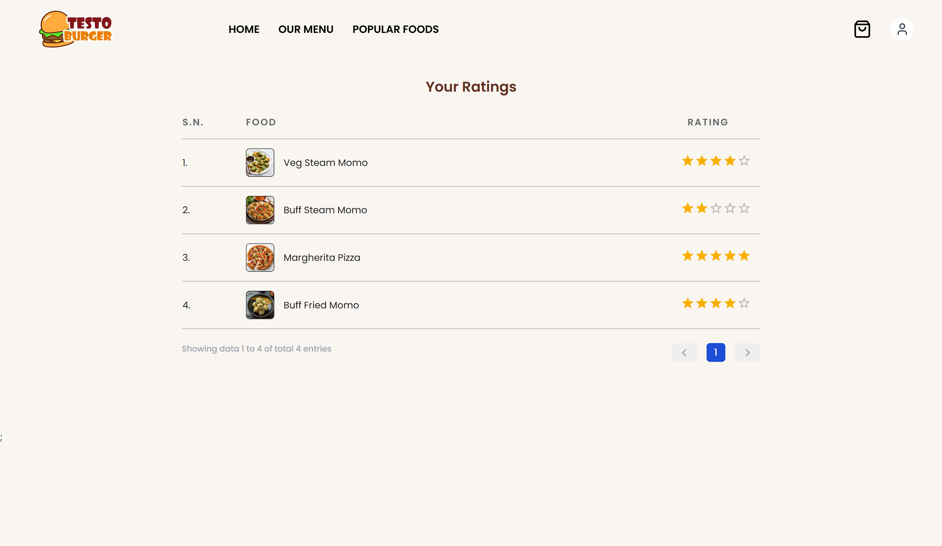

Slide 14

THANK YOU

